Slide 1
Modeling Parking Demand – A Survey Design Approach
Chang-Jen Lan, Ph.D., P.E.
Town of Jupiter

Slide 2
Parking surveys at peak time periods
Reconcile demand via design survey
sustainable parking & land development
Balance among parking, traffic & land development
Over supply
Under design
Over-supplied parking

Slide 3
Issues with Parking Demand
Parking is always a contentious issue: - Residents want ample parking spaces for convenience - Developer/business owner want balanced parking that take into accounts both business operation and developable land - Planners may desire minimum parking to preserve green space and avoid excessive pavement
ample parking is needed so the drivers do not constantly circulate to locate parking space
designing parking spaces to meet peak-day demand in high season might be an overkill

Slide 4
Parking Survey Data
Sources: (1) ITE Parking Generation (5th edition); (2) Urban Land Institute (ULI); and (3) International Council of Shopping Center (ICSC)
Due to financial constraint, surveys could not be conducted all year around. Less (more) samples are collected in lower (higher) demand periods
The busiest days of week during high season are selected for parking survey to capture the peak demands
The 85th (or higher) percentile of high demand data were taken as the industrial standard for parking supply

Slide 5
Survey Design Method Non-parametric Approach
Stratified sampling method (1) Quantify sample size (p_{i}) in each stratum (2) Quantify population size (P_{i}) in each stratum (3) Calculate post-stratification sampling weight (= P_{i}/p_{i}) (4) Perform weight trimming if necessary (5) Determine 85th percentile parking demand from the weighted cumulative histogram
Weight trimming – Extremely high or low weights with low probability of occurrence are trimmed, and the excess is redistributed to the untrimmed weights

Slide 6
Survey Design Method - Parametric Approach
Stratified sampling method (1) Quantify sample size (p_{i}) in each stratum (2) Quantify population size (P_{i}) in each stratum (3) Calculate post-stratification sampling weight (= P_{i}/p_{i}) (4) Perform weight trimming if necessary (5) Calculate combined mean and variance (6) Determine 100(1-α)th percentile parking demand based on log-normal distributional assumption

Slide 7
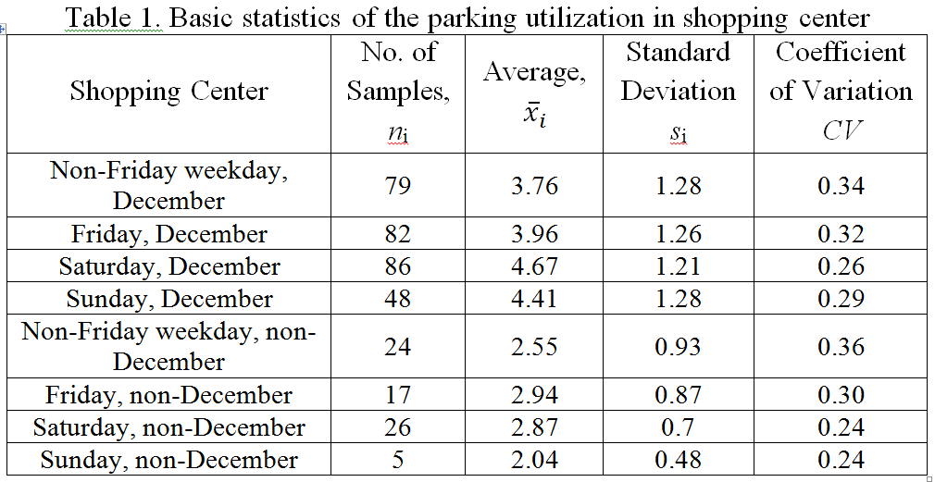
Example: Retail Parking Ratio

Slide 8
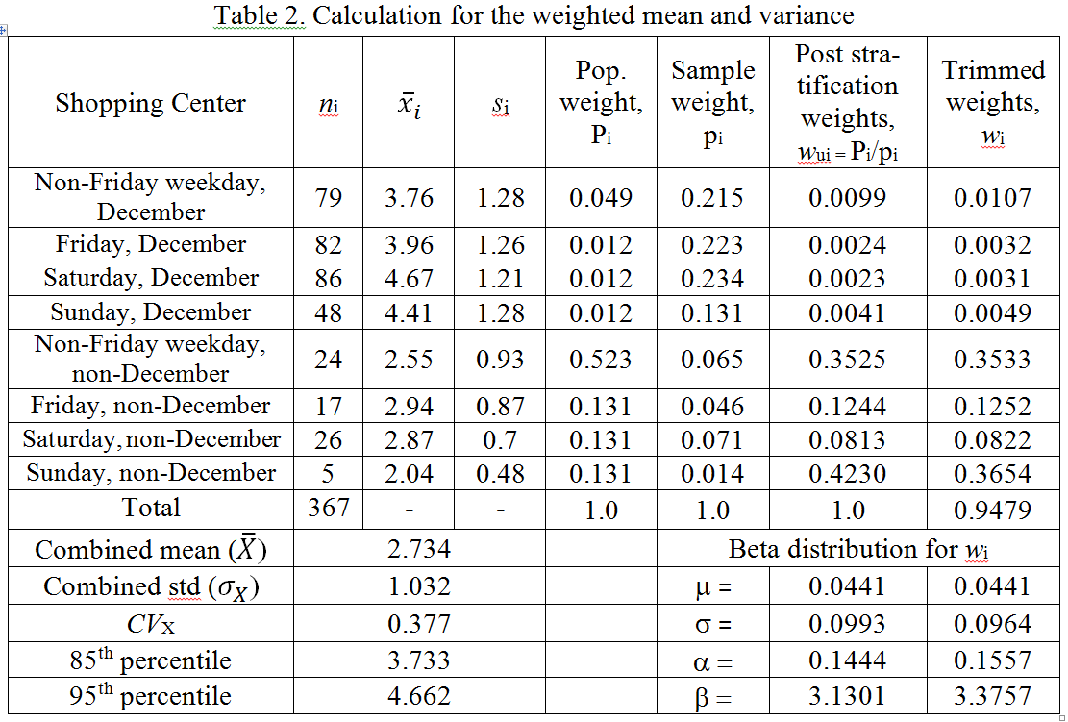
Weight Calculation

Slide 9
Conclusions
Design survey method provides a systematic statistical procedure to reconcile parking ratios for whole year, using the parking data surveyed in different days of week in season or off-season period
Avoid supplying excessive parking to encourage the use of alternative modes of transportation
Balanced parking is a key to sustainable transportation infrastructure

